Slide 1
Lecture-8
Diode Circuit Problems

Slide 2
Review
Diffusion Current
Drift Current
Voltage Barrier
Forward Bias
Reverse Bias

Slide 3
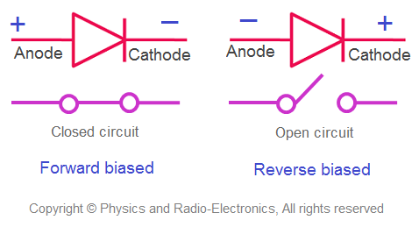
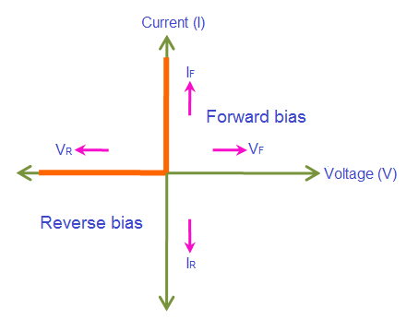
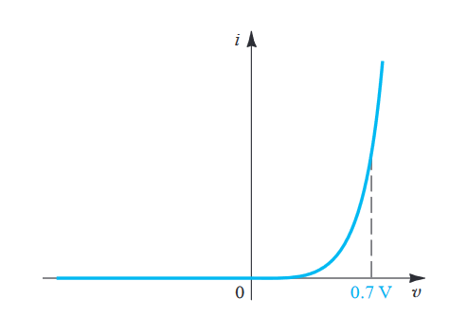
Diode Circuit Models
Ideal Versus Real Diode
Constant Voltage Drop (CVD) Model
Ideal Model
Real / Shockley Model
Low Accuracy
Increased Accuracy
CVD with resistance (CVD+R) Model
Simple
More Complex

Slide 4
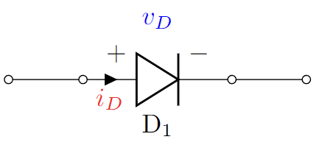
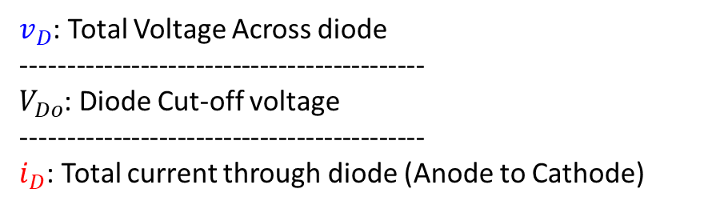


Diode Circuit Models
}
Ideal Diode Model:
Constant Voltage Drop (CVD) Model:
Constant Voltage Drop with Resistor (CVD+R) Model
Exponential Model (Shockley Model):
Piecewise Linear IV Models
$v_{D}$: Total Voltage Across diode
--------------------------------------------
$V_{Do}$: Diode Cut-off voltage
--------------------------------------------
$i_{D}$: Total current through diode (Anode to Cathode)

Slide 5
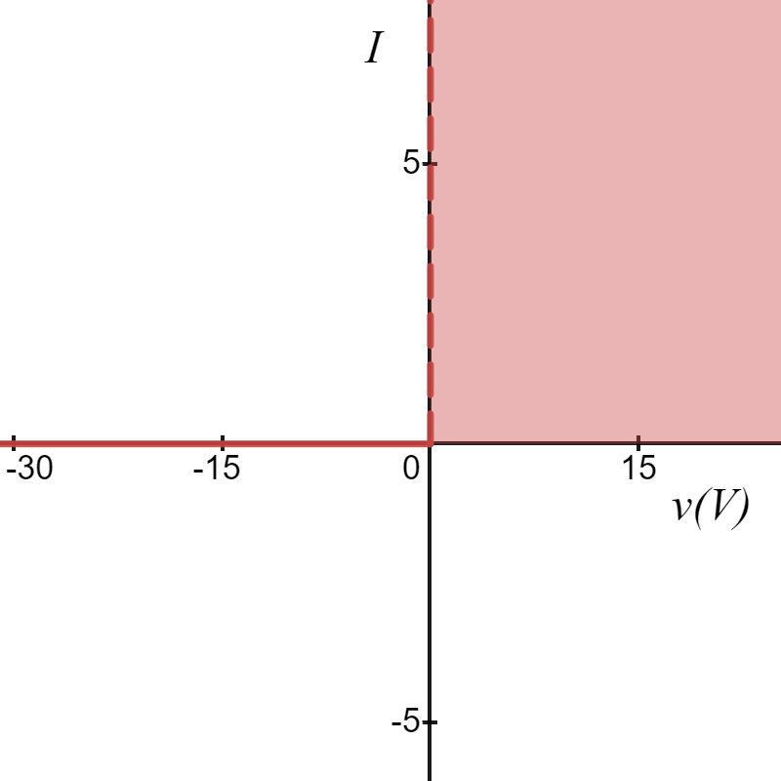





Diode Models
Ideal Diode Model:
$$I_{D}(mA)$$
Forward Bias
$$i_{D}=0$$
$$v_{D}<0$$
$$i_{D}>0$$
$$v_{D}=0$$
$V_{Do}=0$V
$$v_{D}(V)$$
Reverse Bias

Slide 6
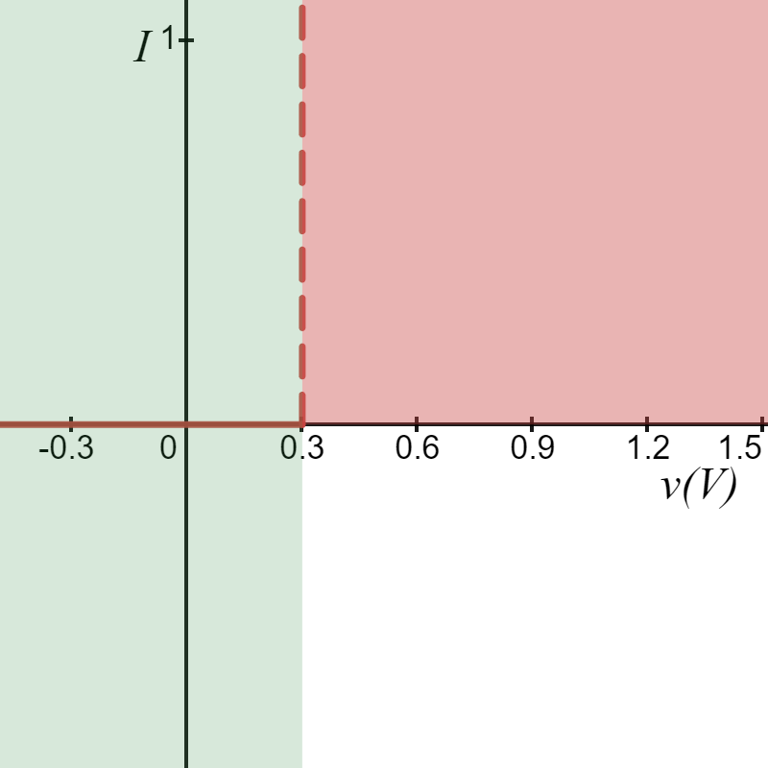
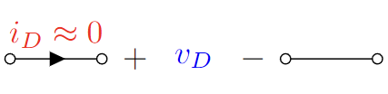
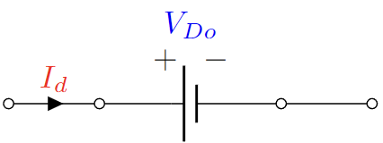




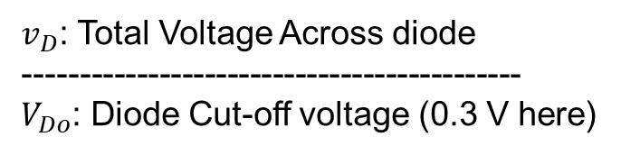

Diode Models
$$I_{D}(mA)$$
2. Constant Voltage Drop (CVD) Model:
Reverse Bias
Forward Bias
$V_{Do}=0.3$V
$$v_{D}(V)$$
$$i_{D}=0$$
$$v_{D}<V_{Do}$$
$$i_{D}>0$$
$$v_{D}=V_{Do}$$
$v_{D}$: Total Voltage Across diode
--------------------------------------------
$V_{Do}$: Diode Cut-off voltage (0.3 V here)

Slide 7




Diode Models
$$I_{D}(mA)$$
2. Constant Voltage Drop (CVD) Model:
Reverse Bias
Forward Bias
$$y=0$$
$$v_{D}=V_{Do}$$
$V_{Do}=0.3$V
$$v_{D}(V)$$
$$x=V_{Do}$$
$v_{D}$: Total Voltage Across diode
--------------------------------------------
$V_{Do}$: Diode Cut-off voltage (0.3 V here)

Slide 8
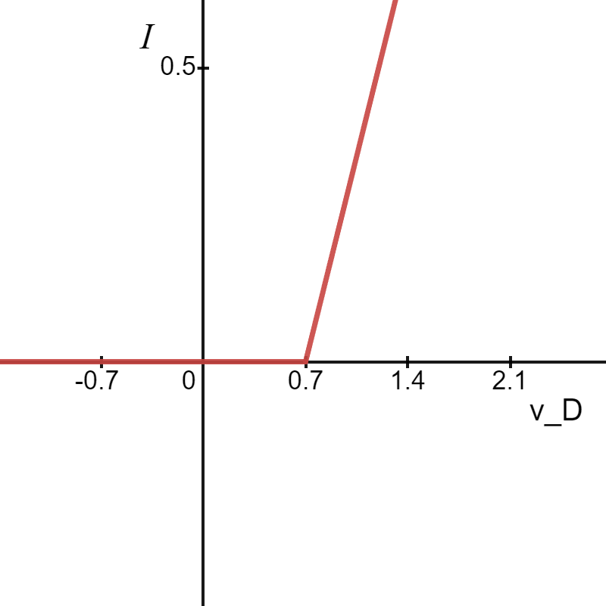
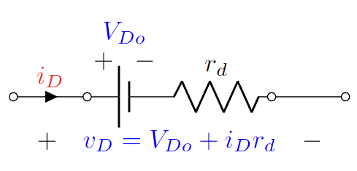

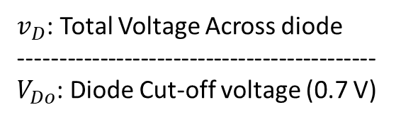



Diode Models
3. CVD+R Model:
$$I_{d}(mA)$$
Reverse Bias
Forward Bias
$V_{Do}=0.7$V
$$v_{D}(V)$$
$v_{D}$: Total Voltage Across diode
--------------------------------------------
$V_{Do}$: Diode Cut-off voltage (0.7 V)

Slide 9
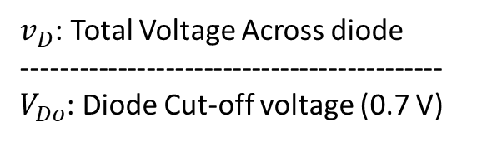




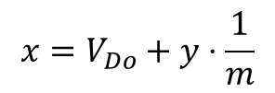
Diode Models
3. CVD+R Model:
$$I_{d}(mA)$$
Reverse Bias
Forward Bias
$$y=0$$
$V_{Do}=0.7$V
$$v_{D}(V)$$
$$x=V_{Do}+y⋅\frac{1}{m}$$
$v_{D}$: Total Voltage Across diode
--------------------------------------------
$V_{Do}$: Diode Cut-off voltage (0.7 V)

Slide 10
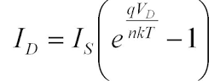
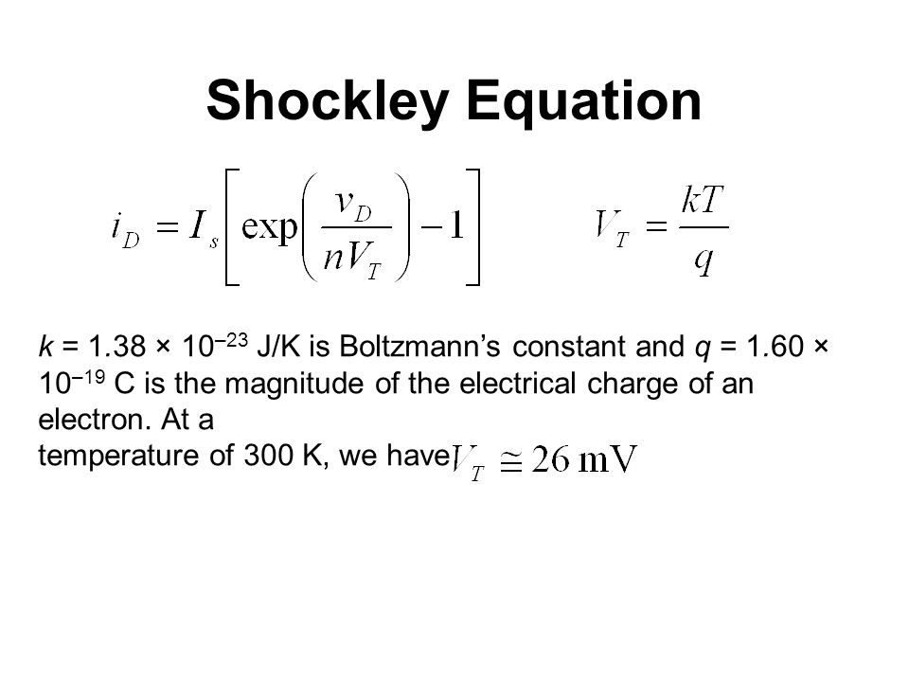


Diode Models
$$I_{D}(mA)$$
4. Shockley Diode Equation Model:
$$v_{D}(V)$$
Where I_{S} is reverse saturation current

Slide 11
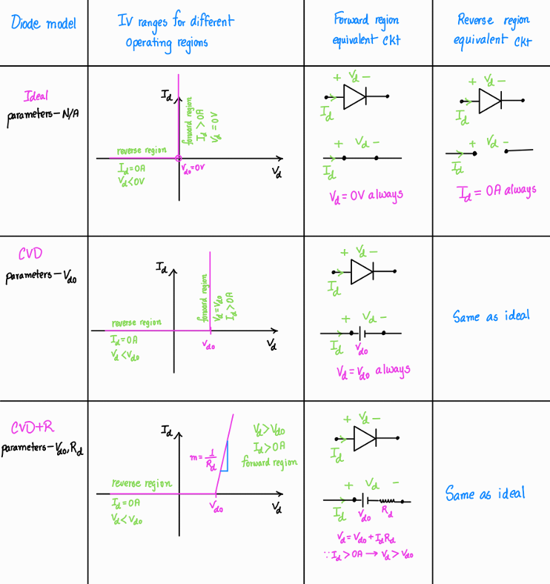

Slide 12
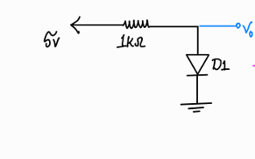
Solving Ckts with diodes

Slide 13
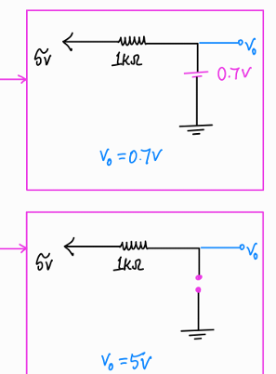
Solving Ckts with diodes
So we have to determine the diode state before solving the circuit
Method of Assumed State(MAS)- Trial and error

Slide 14
Method of Assumed State
Assume the state of the diodes present in the ckt
Replace the diode with their state equivalent ckts
Solve Diode voltage and current
For forward bias assumption: check current
For Reverse bias assumption: check voltage
Verify your assumption
If wrong, assume new combination and repeat the previous steps

Slide 15
Solving Ckts with diodes
Which one is correct?

Slide 16
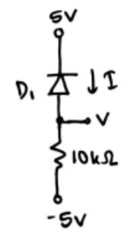
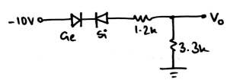

Problem 1(Use CVD model)
(a)
(b)
(c)

Slide 17
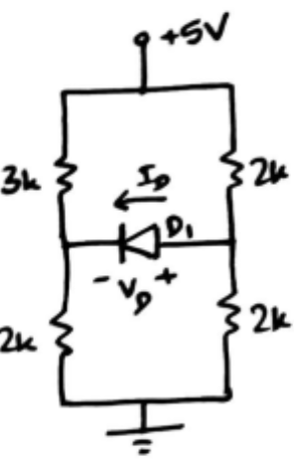
Problem 2(Use CVD model)

Slide 18
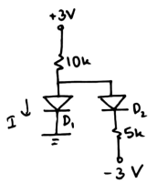
Problem 3(Use Ideal model)

Slide 19
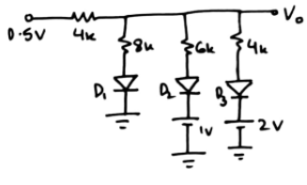
Bonus Task

Slide 20
Thank You!

